Slide 1
Bearing Testing Rig
What Aleks has done

Slide 2
Week 1

Slide 3
Computer
myDAQ
Everything
Else
Electrical Plan
Motor
PSU
Feedback
Loop
myDAQ acts as central control unit for the circuit
Motor PSU is controlled via myDAQ to make the Motor variable
Torque PSU is just on or off
Everything else will include accelrometers
Motor
Unit
Torque
Unit
Torque
PSU

Slide 4
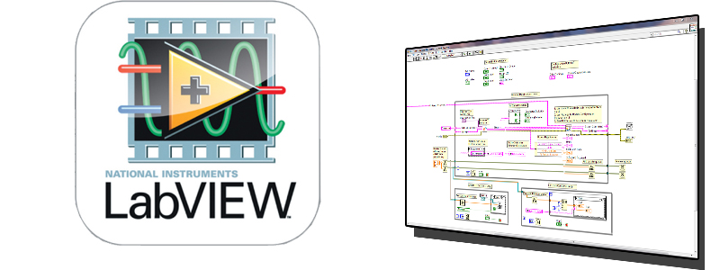
Software Plan
Use LabVIEW

Slide 5
What’s Been Done
Can variably control the motor myDAQ
Need the cable for the torque sensor to do the rest of it
Need to know what “Everything Else” entails
How do we want the data out?

Slide 6
Week 2

Slide 7
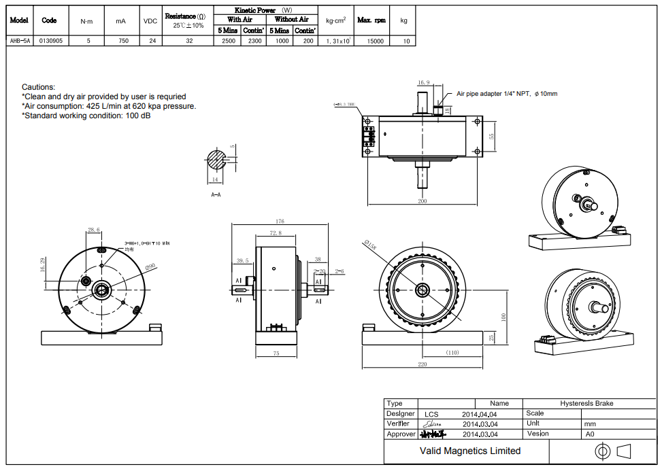
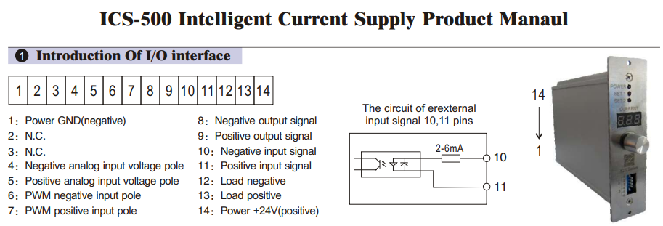
EM Brake: AHB-5 Air-Cooled Hysteresis Brake
Using the one recommended by the capstone report: ABH-5
USD $800
10mm diameter air supply needed
24VDC power supply
Controller: ICS2000
USD $160
Variable Current Controller
24VDC power supply needed
RS485 communication
Other
$50 USD per coupling
Shipping is $200 USD, 2 weeks to arrive
AHB-5 Data Sheet
ICS 200 Interface

Slide 8
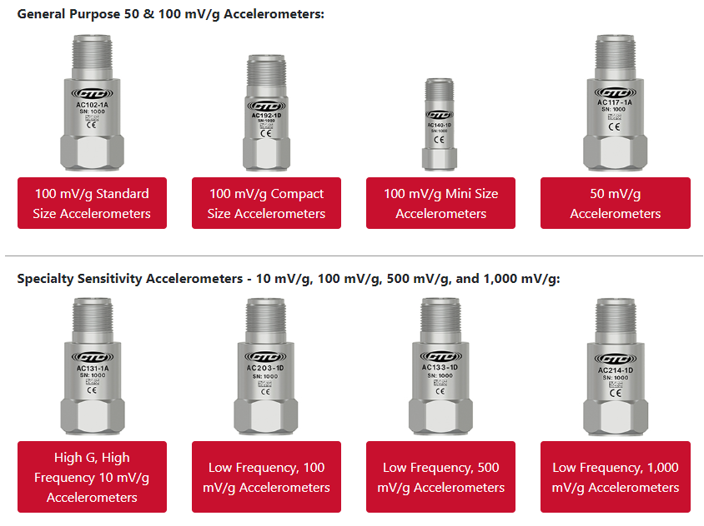
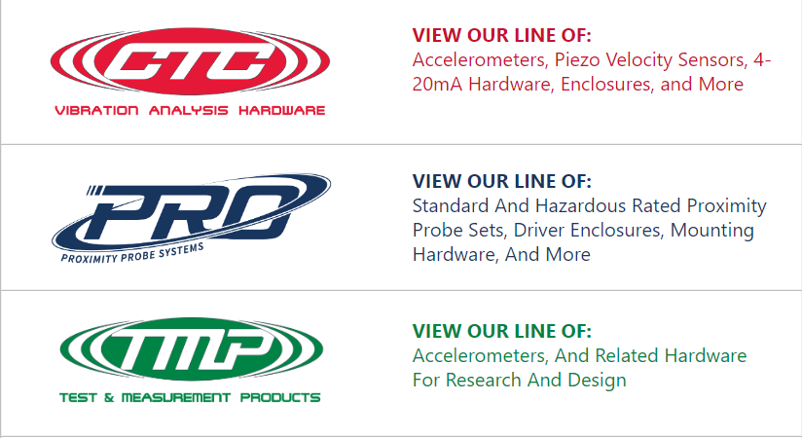
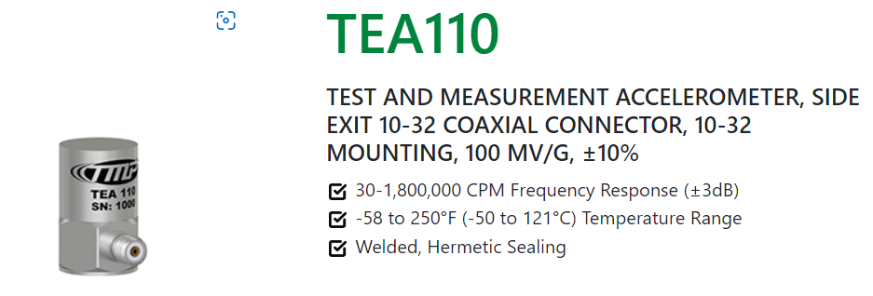
Accelerometers
Using similar model to what capstone group recommended, exact one is not produced anymore
Two styles from CTC: Industrial and Scientific
Capstone recommended an industrial one with 100 mV/g sensitivity
Probably go with similar one, but need further input into the frequency range we’re expecting to measure (kilohertz , usually 1-5kHz, 1 accelerometer for low frequency and 1 for high)
Industrial Options
CTC Types
Scientific Option

Slide 9
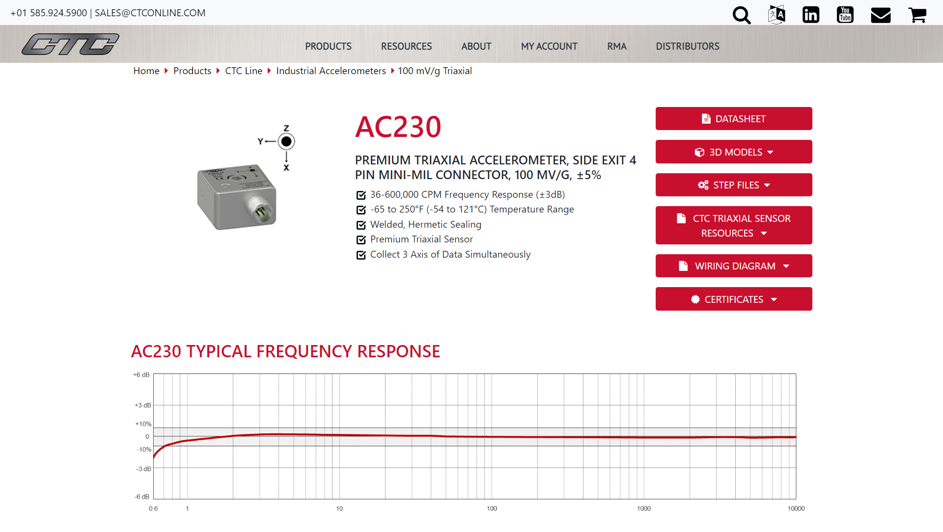
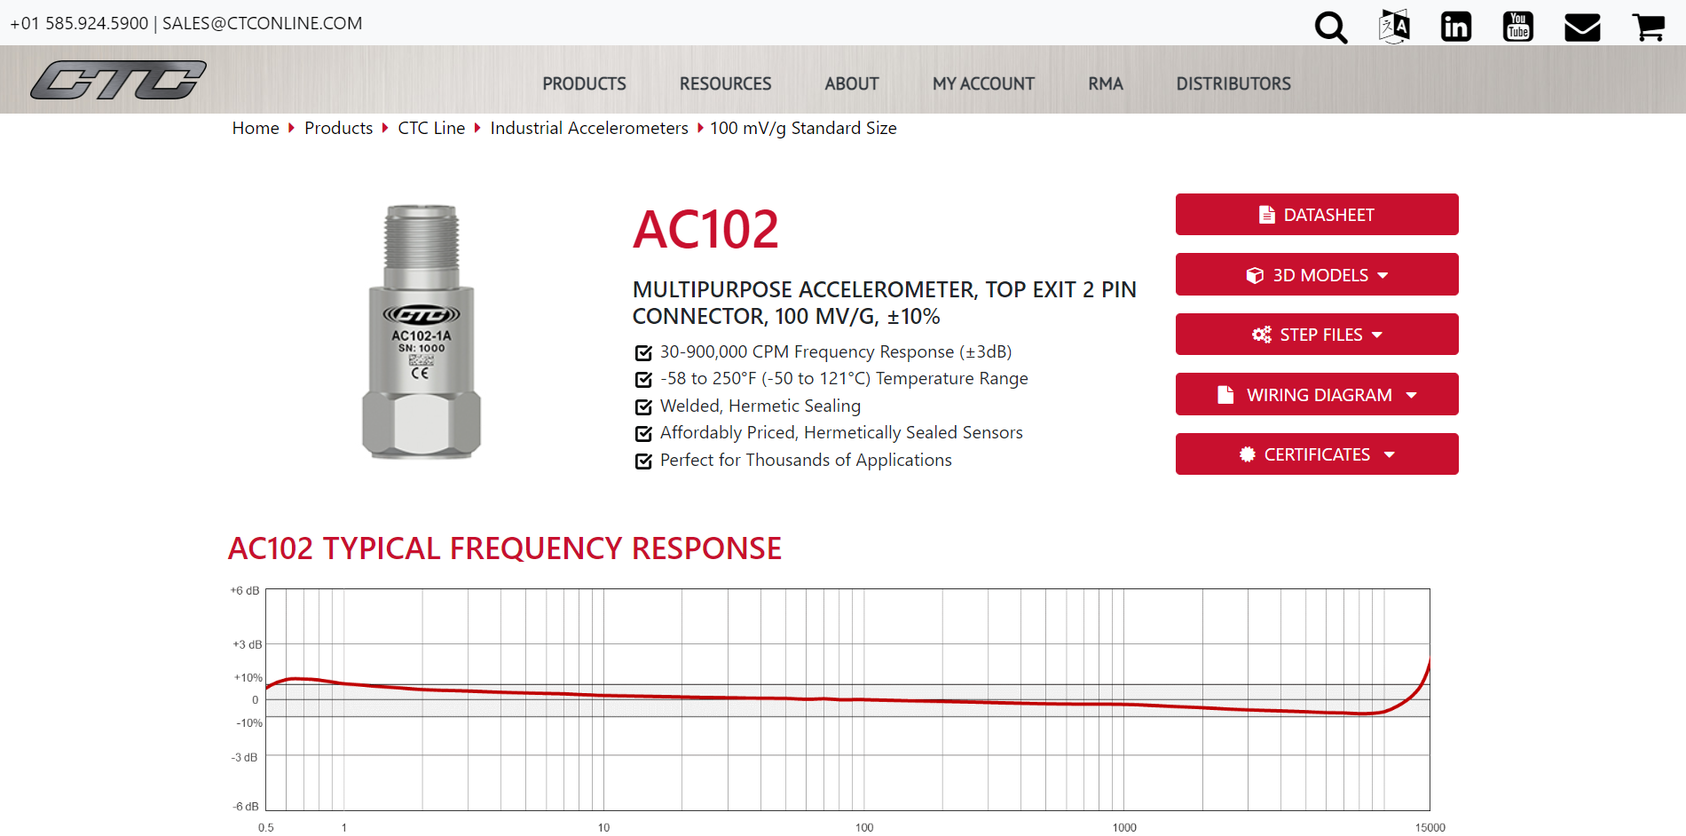
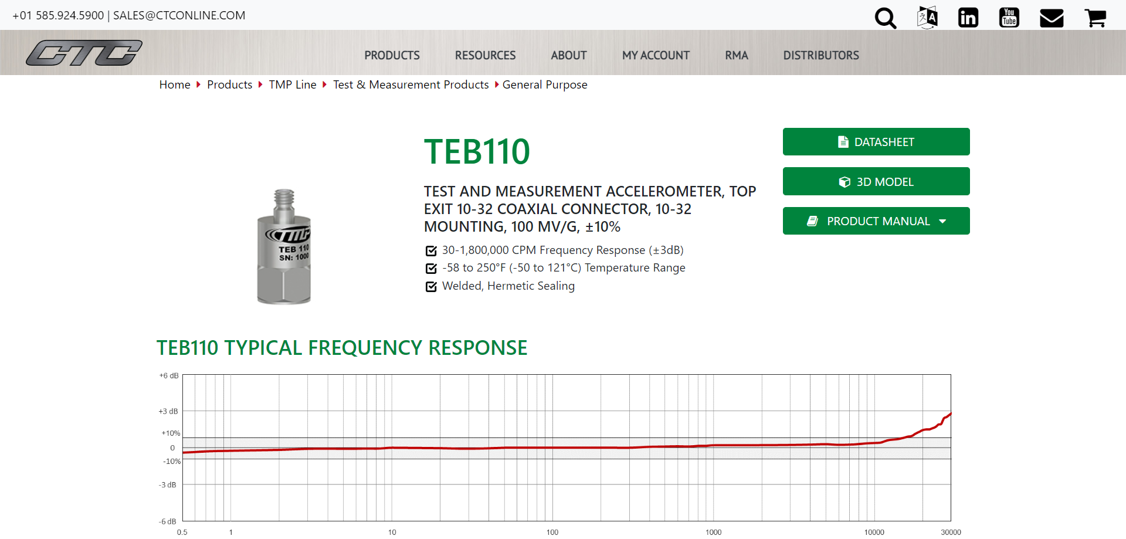
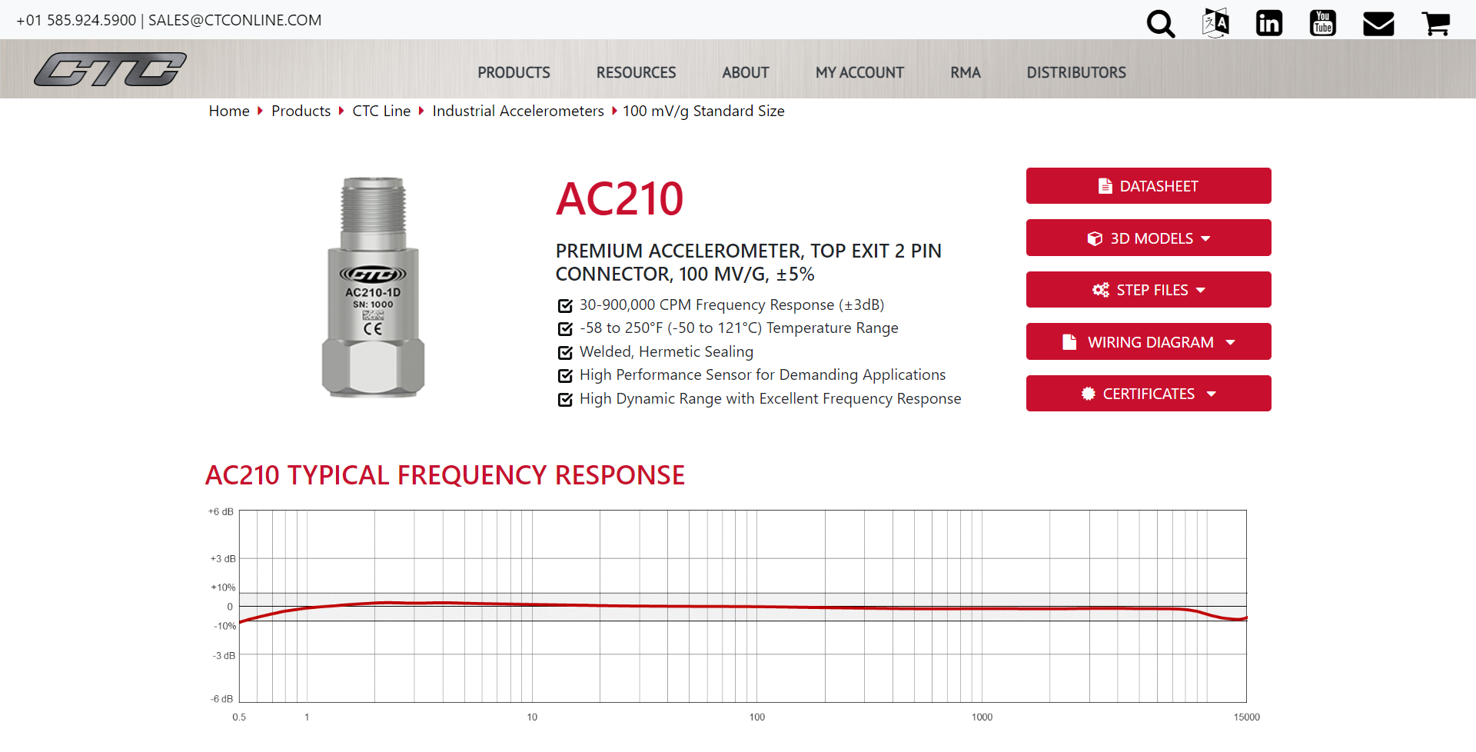

Slide 10
Pricing
Recommend AC210
Very high frequency range
Good sensitivity
Low error margin
Good price

Slide 11
Week 3

Slide 12
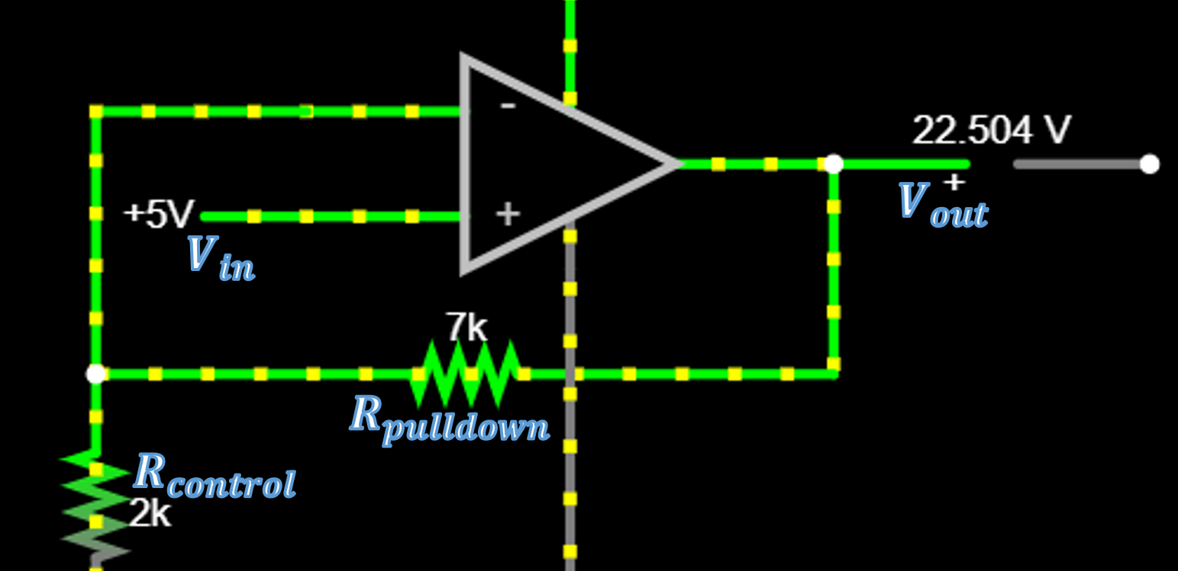
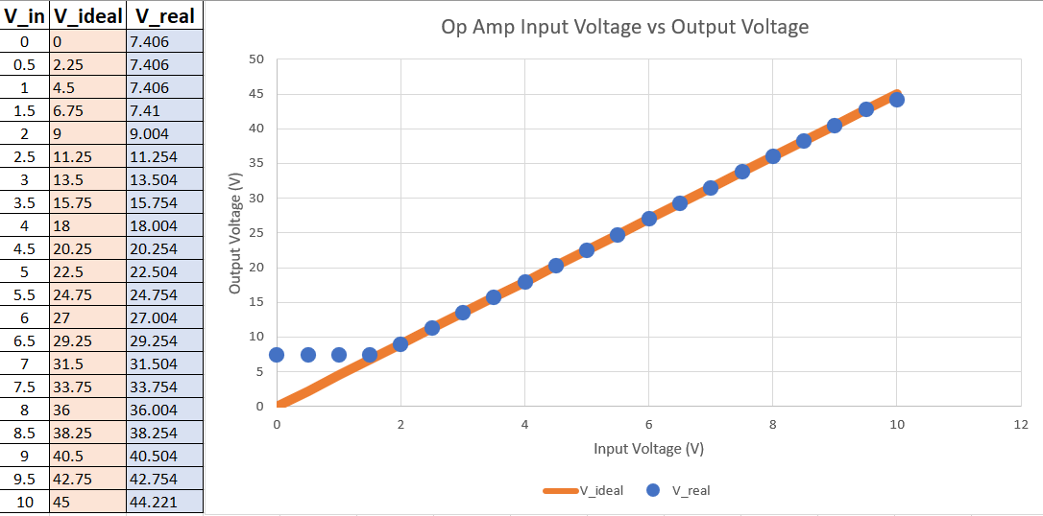
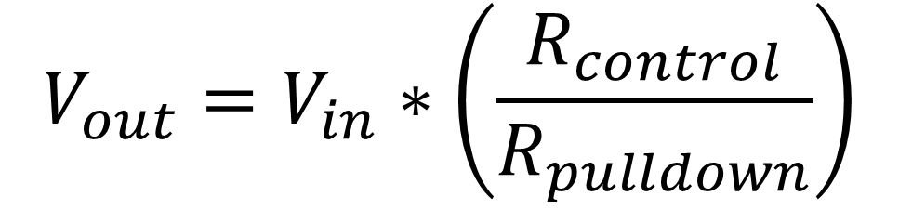
DAQ Amp
Goal is to linearly increase the DAQ to give it a full voltage range
Non ideal voltage is not a problem because it’s a feedback loop
Highest price part of the system is getting a 45v output from the wall, could use a spare power supply if we have one
$183.34 total with new power supply
$39.84 without

Slide 13
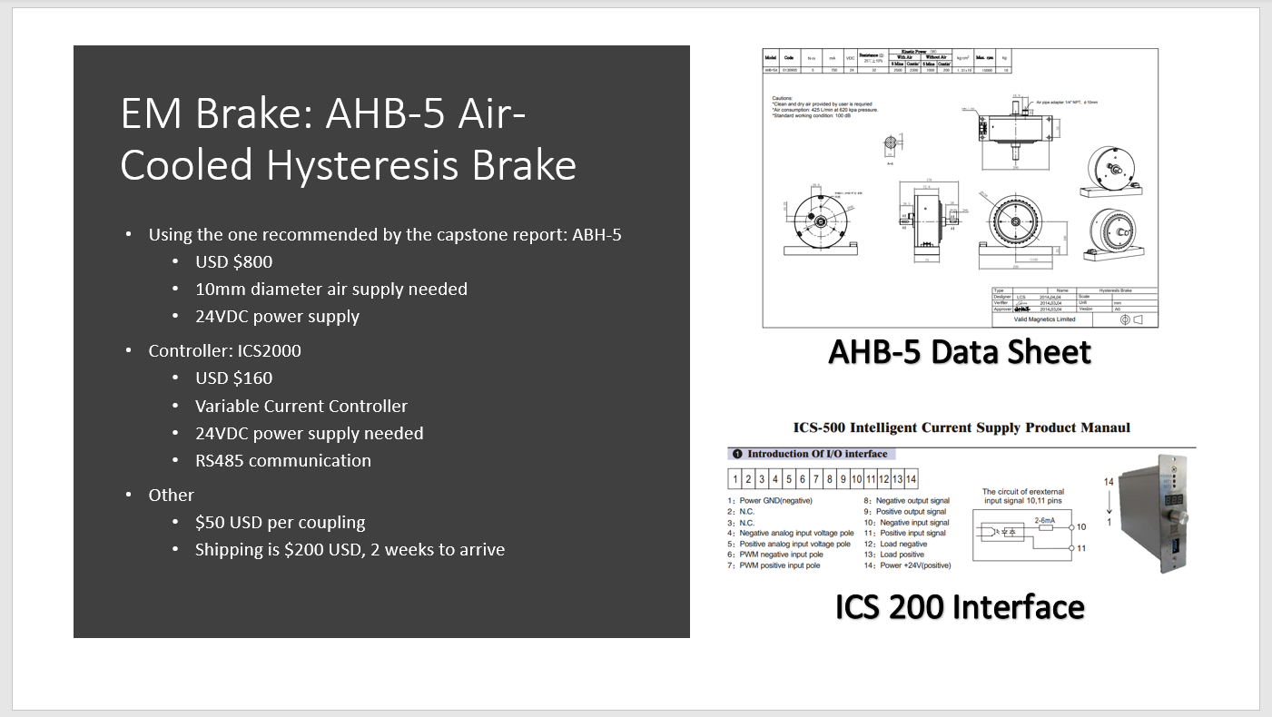
The Load
TL;DR: EMP Break is easy to use and is used in a lot of test rigs. Generator is confusing and I don’t see any pros to it*
From Iurii Storozhenko:
Two types of loads: Electromagnetic particle break and Generator.
EMP break
Simplest : Easy to use, and easy to control
Usually used in test rigs
Torque can be controlled very accurately
Ideal for tension control, load simulation, cycling/indexing, and soft starts and stops
If goal is to use vibration from the drivetrain and not current signals from the generator, this is ideal
Generator
Main limitation is the control system
Not sure of range where we can control the load with permanent magnet generator
Control system of a doubly-fed induction generator is one of the most complicated
Speed range in a wind turbine in which the generator can be operated is about +-30% of the generator's nominal speed.
Also need to make the gearbox gear ratio appropriate to the generator
*this is very outside of my area of expertise, so I may be missing the reason we’re thinking of a generator at all
Refer back to
week 2 slide

Slide 14
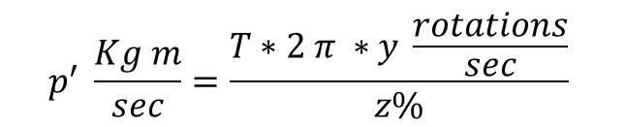
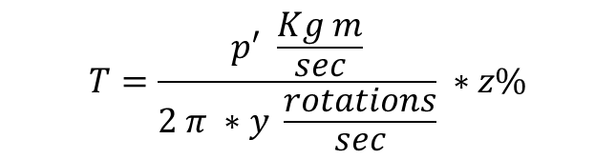
Finding A Generator
$$T=\frac{p^{′} \frac{Kg m}{sec}}{2 π ∗y \frac{rotations}{sec}} ∗z\%$$
Generator Specs:
p = Rated Power in Watts
z = Generator Efficiency in Percent
Variables:
T = Torque in (hopefully) Newton Meters
p’ = Rater Power in Kg-m/s
y = Shaft rotations per second
$$p^{′} \frac{Kg m}{sec}=\frac{T∗2 π ∗y \frac{rotations}{sec}}{z\%}$$
p’ in
Kg-m/sec
p in Watts
Need help finding y, T, and z.
Use power in watts to find generator

Slide 15
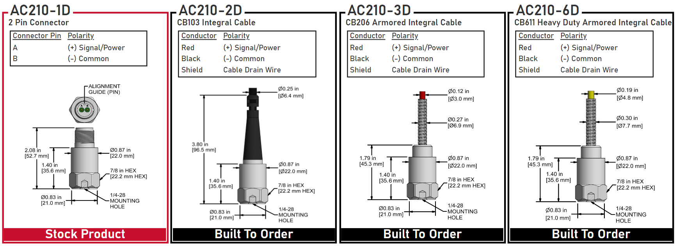
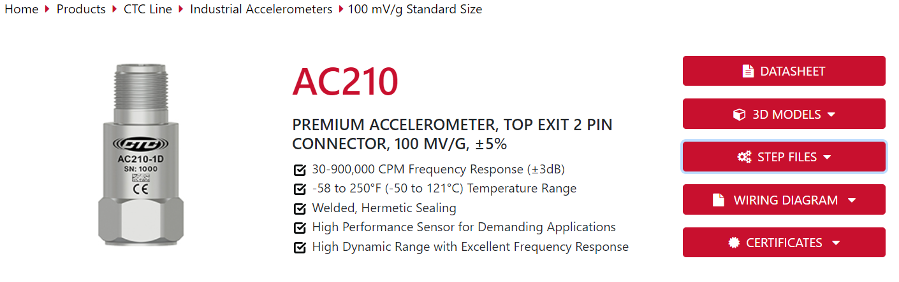
Accelerometer
https://ctconline.com/products/ctc-line/industrial-accelerometers/100-mv-g-standard-size/?prd=AC210
Can choose different cable attachments:
No cable
Integral Cable
Armored Integral Cable
Heavy Duty Armored Integral Cable
CAD and STEP files ready to go

Slide 16
Week 4

Slide 17
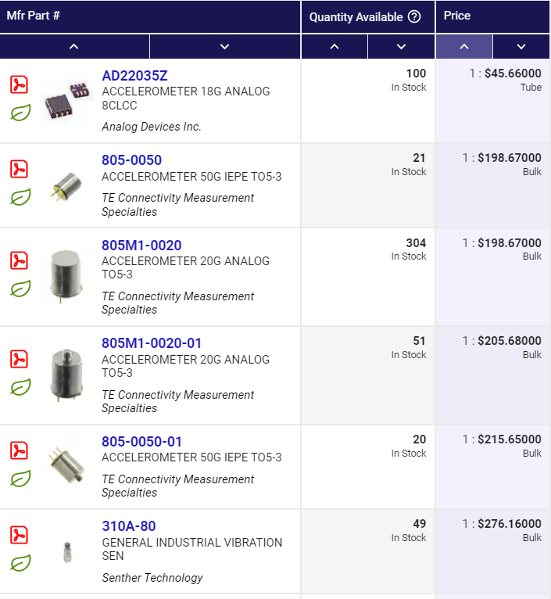
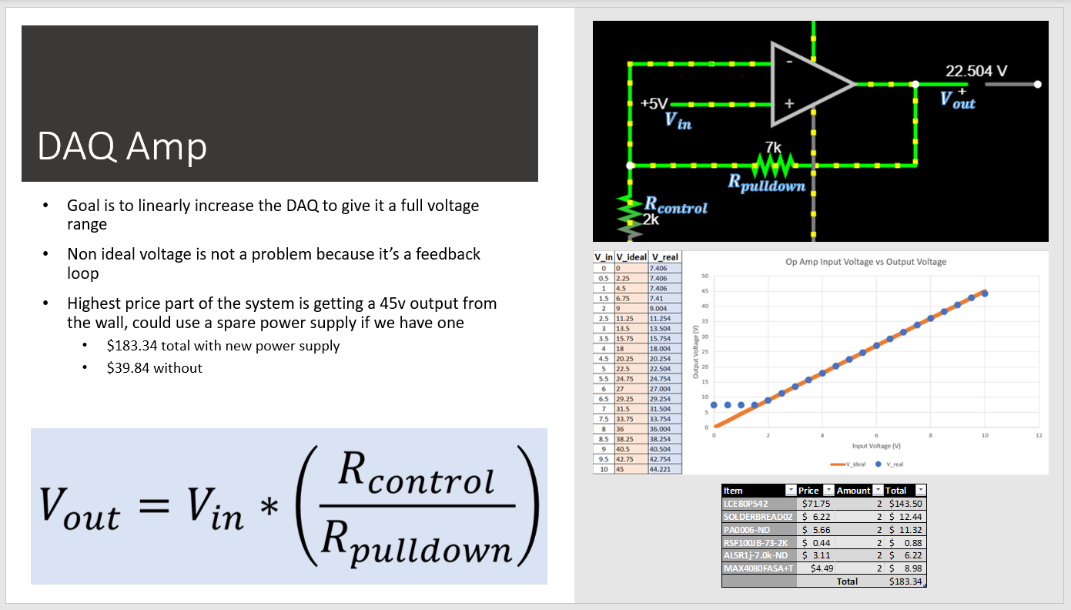
Pricing and Lead Time
Not needed dependent on experiment run time and applied load; need to know what the actual numbers are
Refer back to
week 3 slide

Slide 18
Pricing and Lead Time
Not needed dependent on experiment run time and applied load; need to know what the actual numbers are
Refer back to
week 3 slide

Slide 19
Week 5

Slide 20
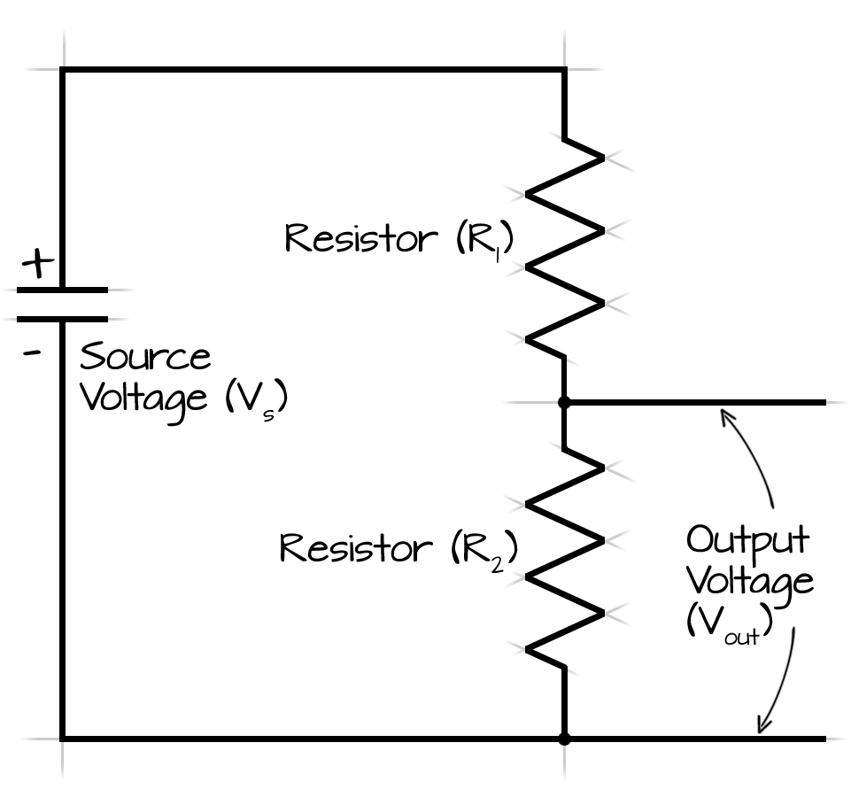
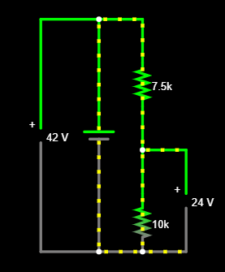
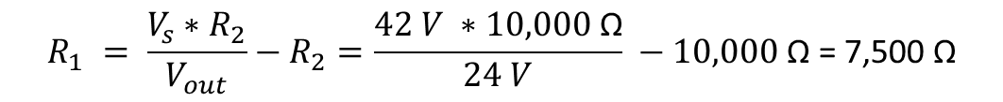
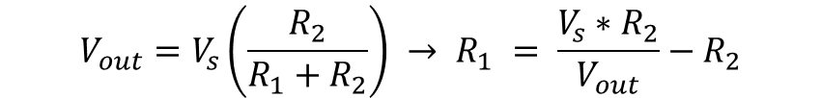
Voltage Divider
Goal is to make the 42V line power the 24V items without needing another power supply
Accomplished with a simple voltage divider
Want to make it low power (low amperage)
$$V_{out}=V_{s}\left(\frac{R_{2}}{R_{1}+R_{2}}\right) → R_{1} = \frac{V_{s}∗R_{2}}{V_{out}}−R_{2}$$
Rearrange voltage
divider equation
$$R_{1} = \frac{V_{s}∗R_{2}}{V_{out}}−R_{2}=\frac{42 V ∗10,000 \text{Ω}}{24 V} −10,000 \text{Ω}\text{ = 7,500 }\text{Ω}$$
Calculate the Two
Resistors Needed
$$i=\frac{V}{R}=\frac{42 V}{7,500 \text{Ω}+10,000 \text{Ω}}=0.0024 A$$
Amperage Used By Resistors
$$P=V∗i=42 V ∗0.0024 A=0.1 W$$
Power Used By Resistors

Slide 21
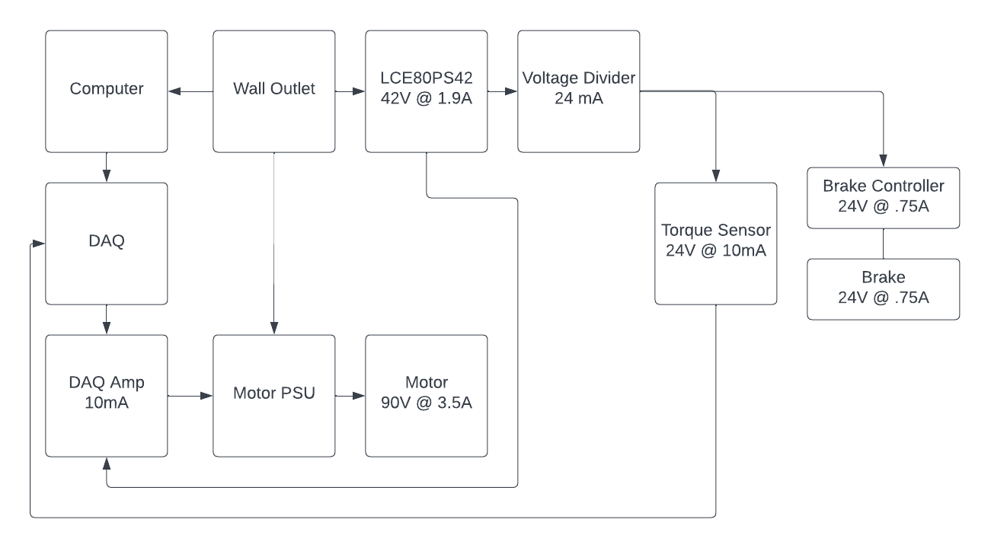
Notes:
All wiring will be done on a protoboard
Accelerometers will be on a separate circuit (with a separate DAQ) due to restrictions of myDAQ
Should see no issues going forward
Full Circuit

Slide 22
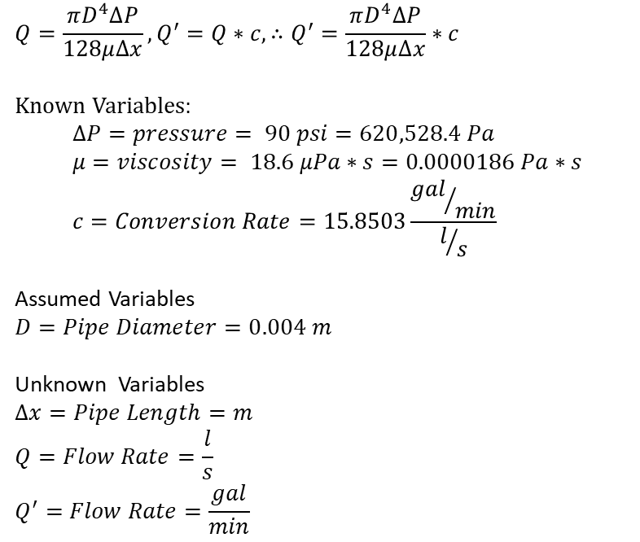
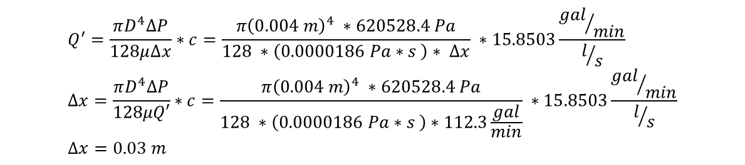
Air Brake Consumption
Air Consumption $= 425\frac{L}{min} @ 620 kpa=112.3\frac{gal}{min} @ 90 psi$
Assuming pipe is laminar, can use the Poiseuille Equation to calculate the flow rate:
$$Q=\frac{πD^{4}∆P}{128μ∆x}, Q^{′}=Q∗c, ∴Q^{′}=\frac{πD^{4}∆P}{128μ∆x}∗c$$
Known Variables:
$$∆P=pressure= 90 psi=620,528.4 Pa \\ μ=viscosity= 18.6 μPa∗s=0.0000186 Pa∗s \\ c=Conversion Rate=15.8503\frac{{gal}/{min}}{l/s}$$
Assumed Variables $$D=Pipe Diameter=0.004 m$$
Unknown Variables
$$∆x=Pipe Length=m \\ Q=Flow Rate=\frac{l}{s} \\ Q^{′}=Flow Rate=\frac{gal}{min}$$
$$Q^{′}=\frac{πD^{4}∆P}{128μ∆x}∗c=\frac{π{\left(0.004 m\right)}^{4} ∗620528.4 Pa}{128 ∗\left(0.0000186 Pa∗s \right)∗ ∆x} ∗15.8503\frac{{gal}/{min}}{l/s} \\ ∆x=\frac{πD^{4}∆P}{128μQ′}∗c=\frac{π{\left(0.004 m\right)}^{4} ∗620528.4 Pa}{128 ∗\left(0.0000186 Pa∗s \right)∗112.3\frac{gal}{min}} ∗15.8503\frac{{gal}/{min}}{l/s} \\ ∆x=0.03 m$$

Slide 23
Week 6

Slide 24
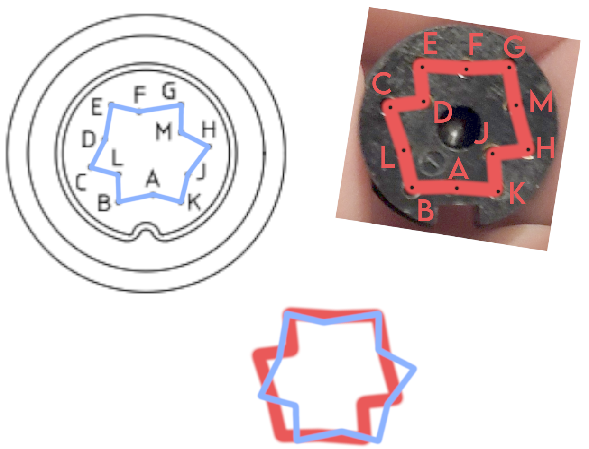
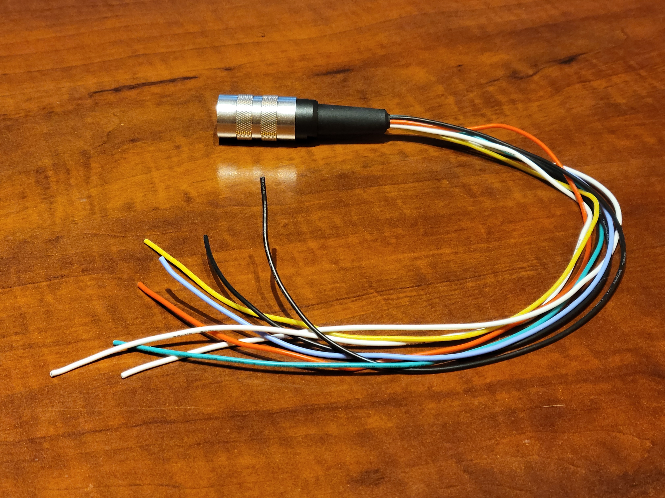
Cable Building
I don’t know who made the diagram, but it’s not accurate
Gave me a headache for a few minutes trying to figure it out
Soldering was a pain

Slide 25
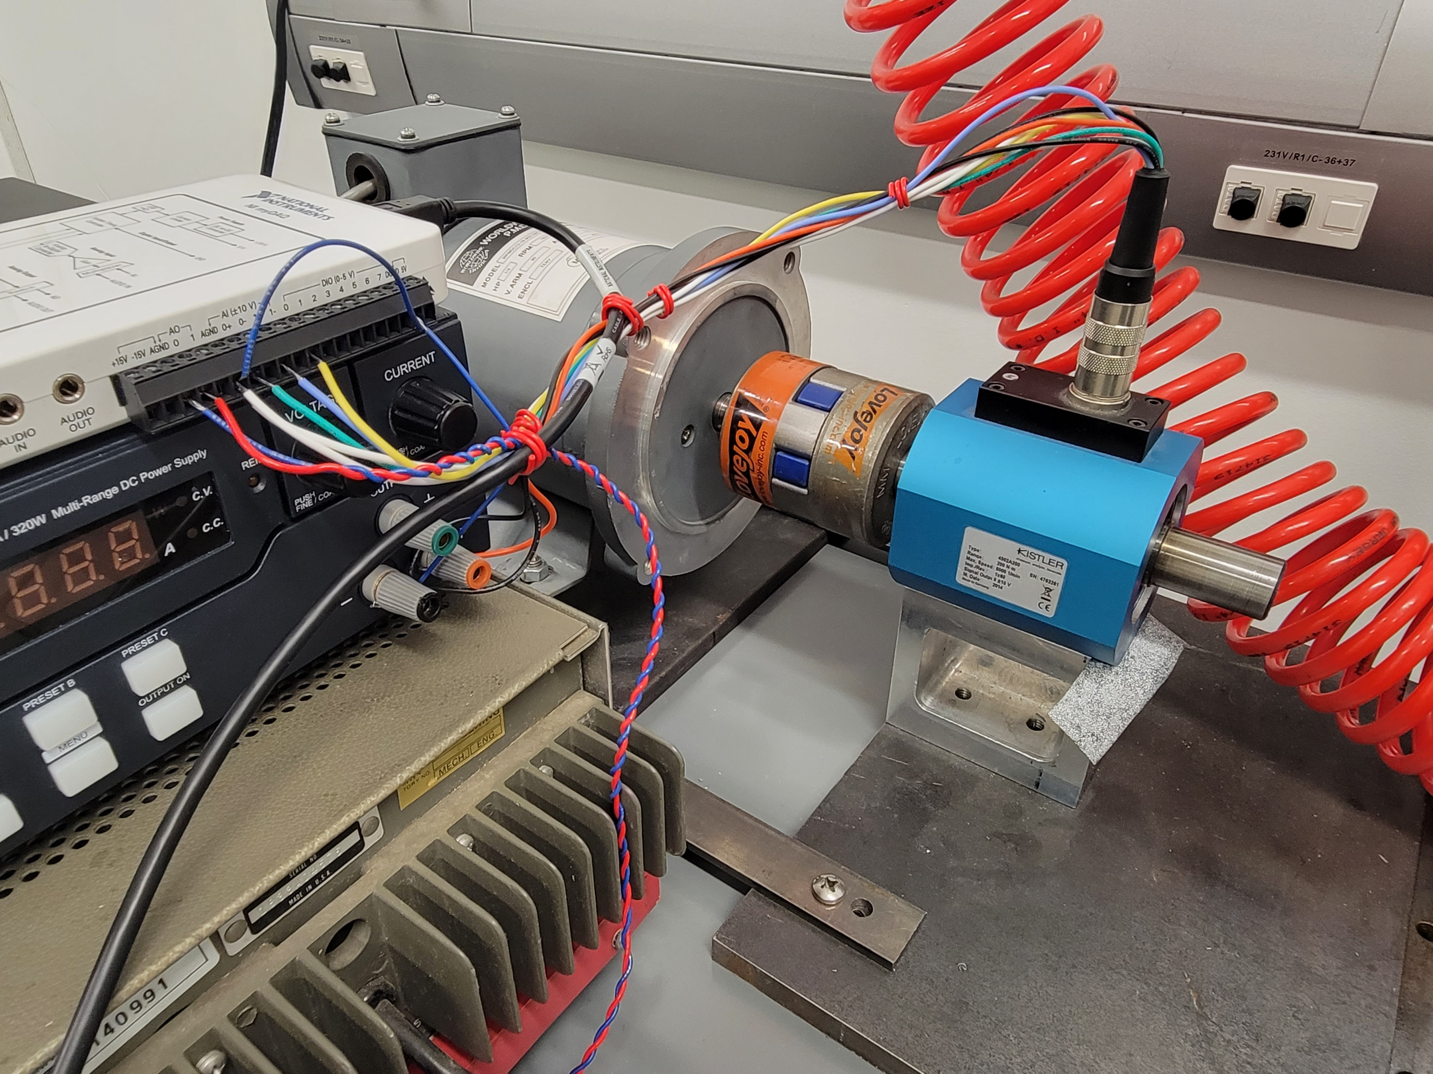
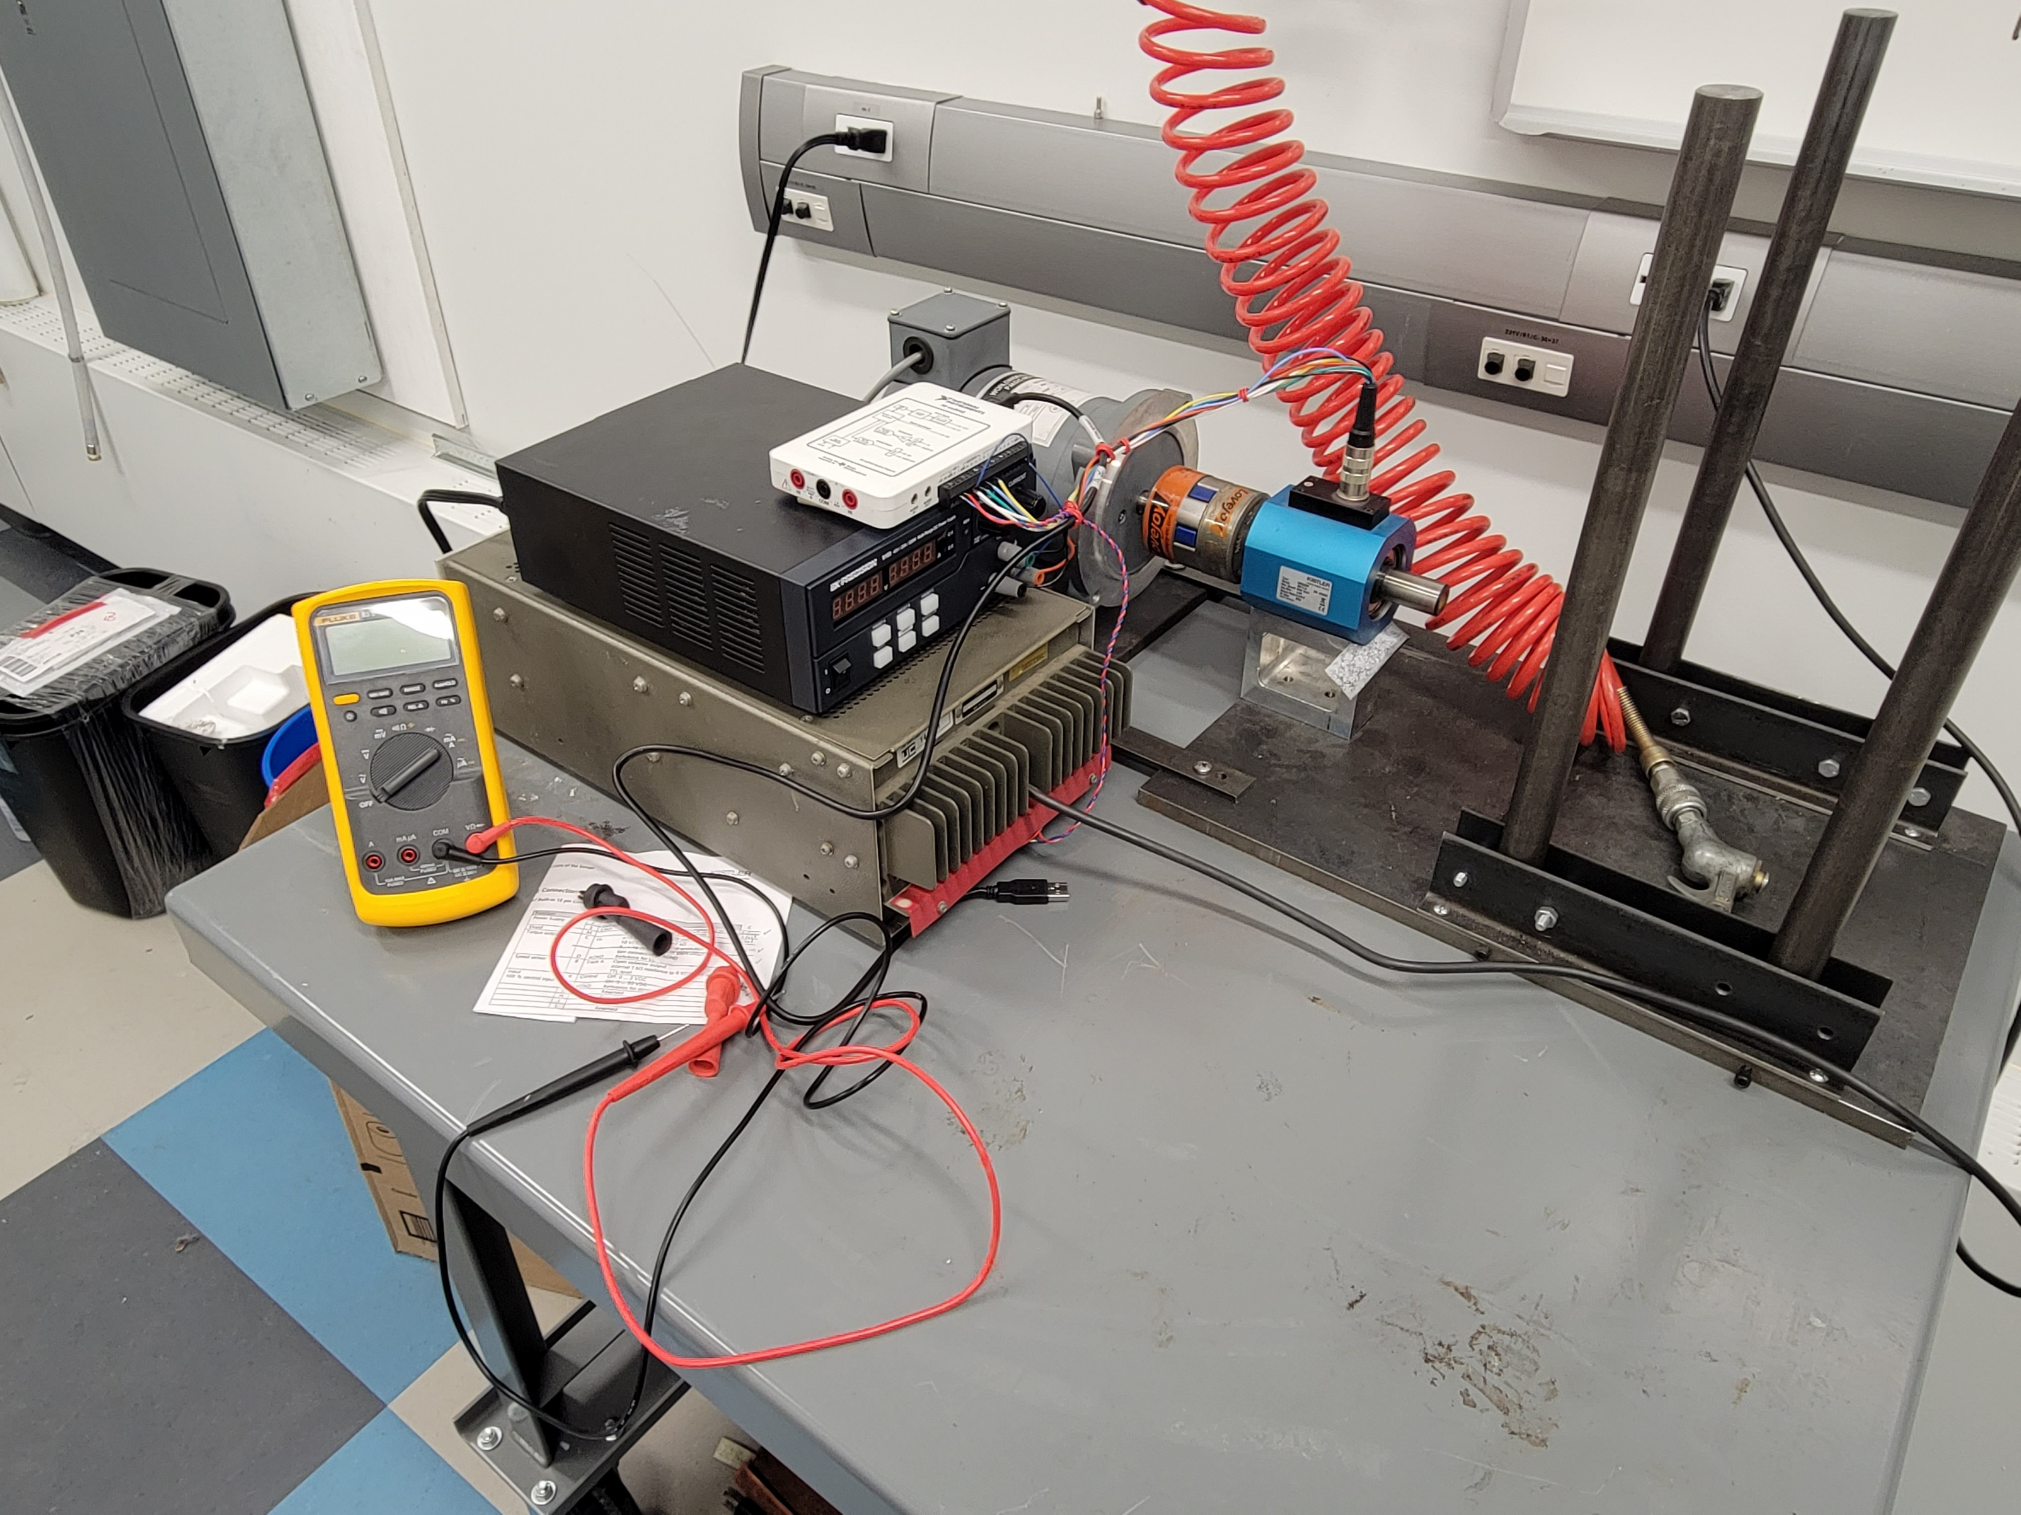
Wiring

Slide 26
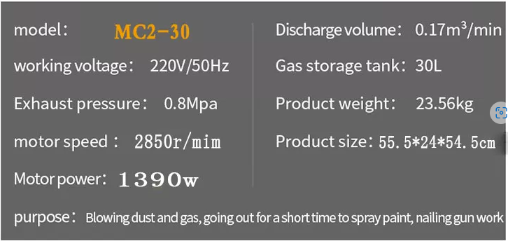
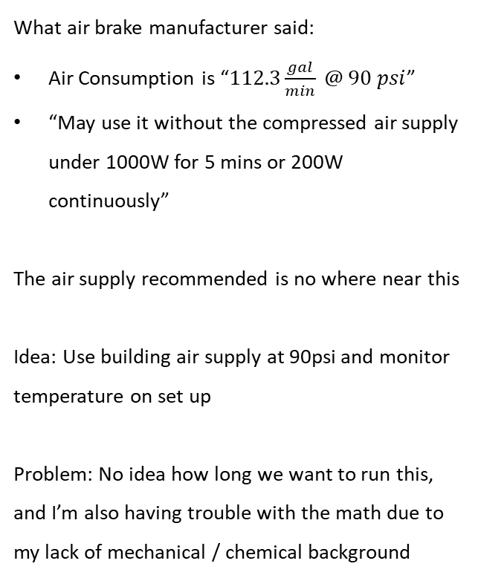
Air Supply
What air brake manufacturer said:
Air Consumption is “$112.3\frac{gal}{min} @ 90 psi$”
“May use it without the compressed air supply under 1000W for 5 mins or 200W continuously”
The air supply recommended is no where near this
Idea: Use building air supply at 90psi and monitor temperature on set up
Problem: No idea how long we want to run this, and I’m also having trouble with the math due to my lack of mechanical / chemical background
Flow Rate:$0.17\frac{m^{3}}{min}=0.748\frac{gal}{min}≠112.3\frac{gal}{min}⁡$
How long it can be used:$0.03 m^{3}∗\frac{1 min}{0.17 m^{3}}=0.17 min=11.6sec$

Slide 27
Week 7

Slide 28
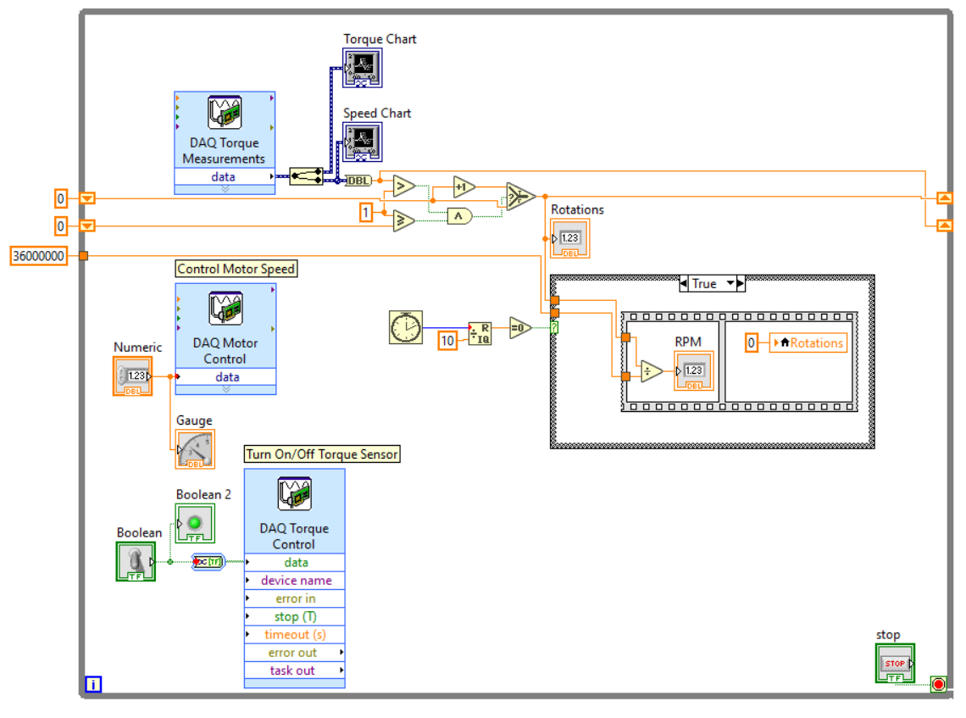
Draft One of the Software is Done

Slide 29
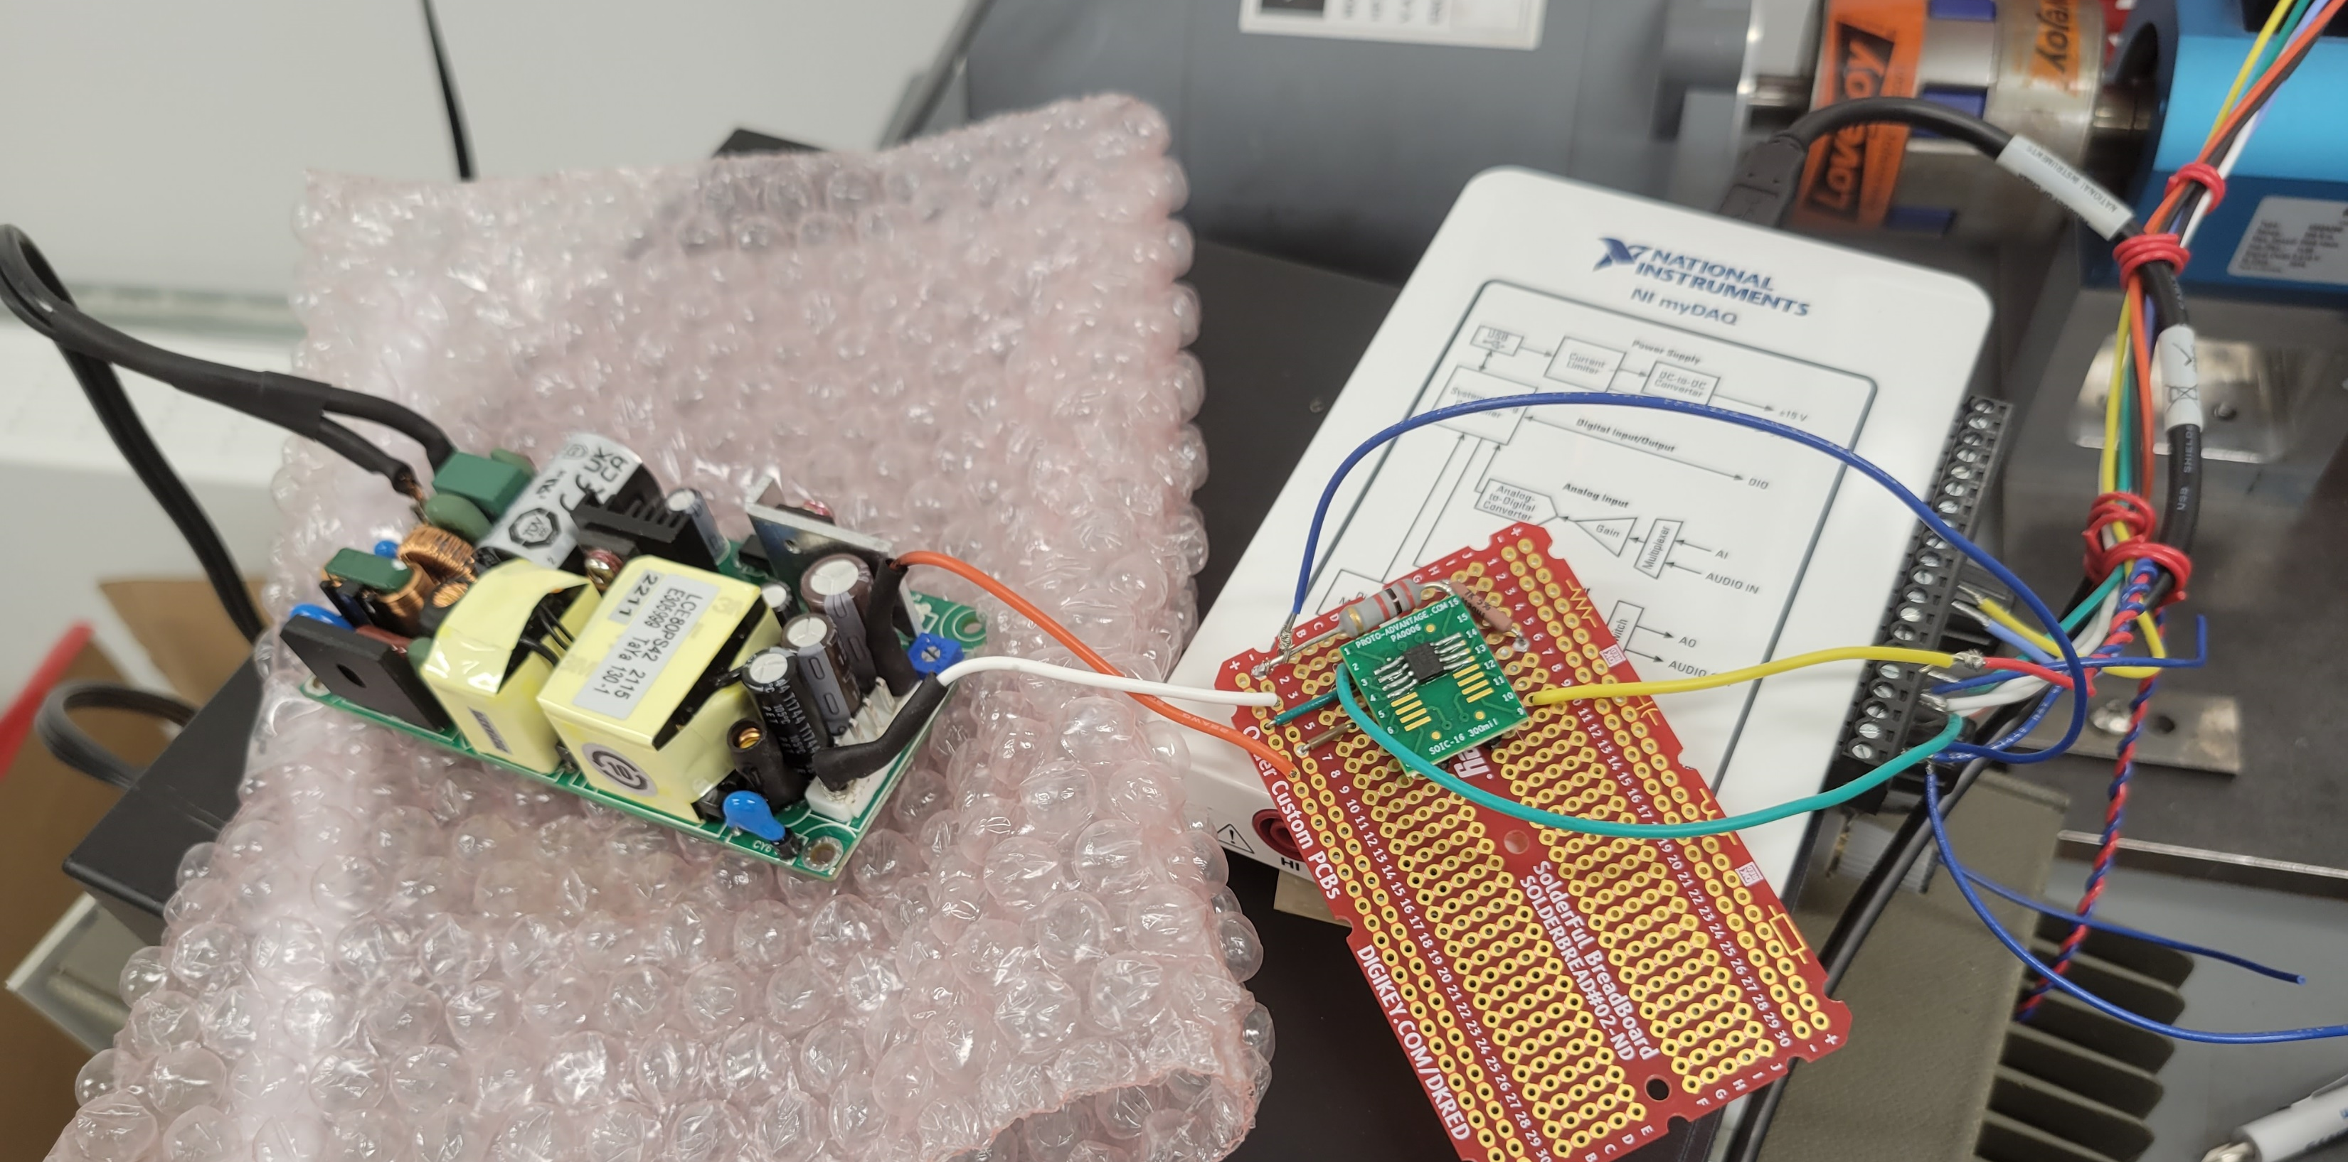
Draft One of
The Electrical
Is Done
Theory behind it works
Need to order a different OpAmp
Need to clean up and make safer
THE MOTOR ACTUALLY GOES

Slide 30
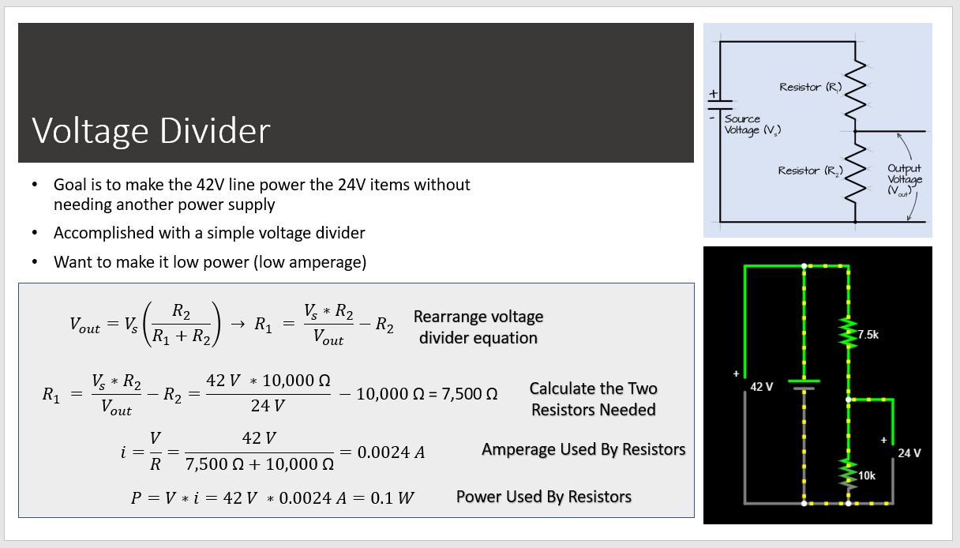
Powering The Brake
Update on Brake Voltage Divider: Can’t actually just use voltage divider,
Need to use actual voltage regulator for 24v stuff; don’t need to get right now because we have a spare PSU

Slide 31
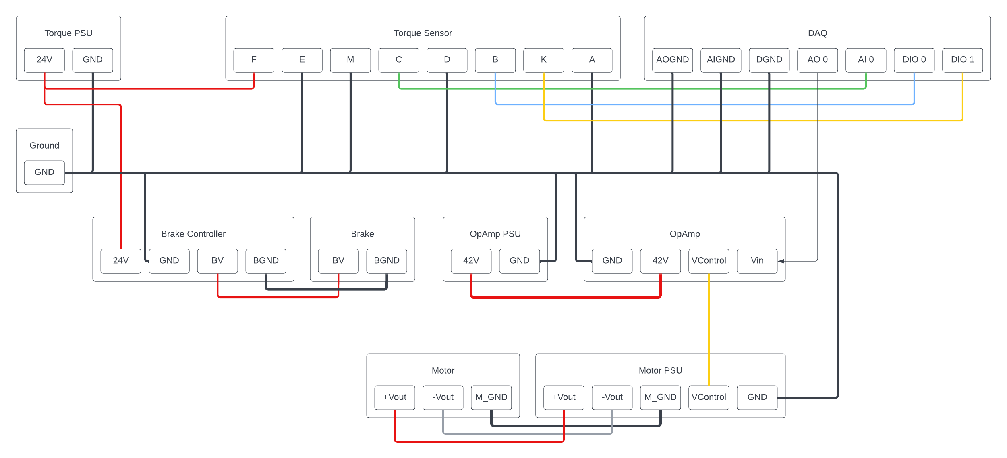
Electrical Wiring Box
Going to make a single box that everything connects into
For cleanliness and safety
Using BNC connectors when possible
D-plug or serial cable - Unsure what type of connector to use when more than 2 wires (such as between Torque Sensor and DAQ)

Slide 32
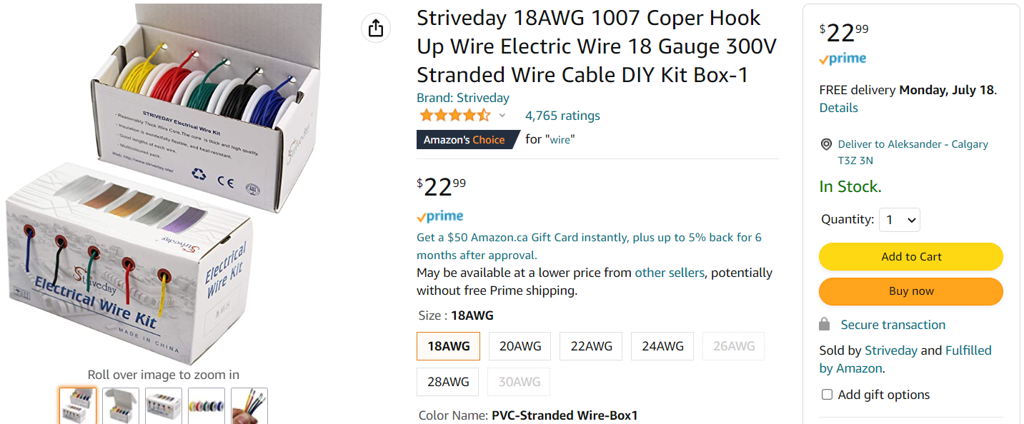
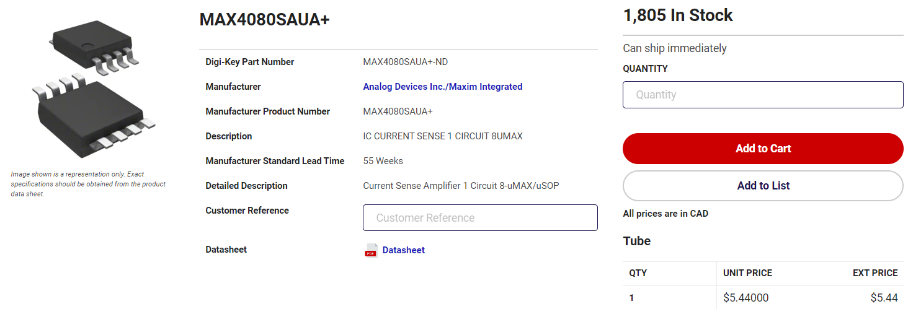
What I Need Ordered
Striveday 18AWG 1007 Coper Hook Up Wire Electric Wire 18 Gauge 300V Stranded Wire Cable DIY Kit Box-1, Electrical Wire - Amazon Canada
MAX4080SAUA+ Analog Devices Inc./Maxim Integrated | Integrated Circuits (ICs) | DigiKey

Slide 33
What’s Next
Order parts
Figure out connections needed for a wire box
Order all parts for wire box
Make wire box
3D Print Casing for converter, solder board, and wire box
Resolder torque sensor wire and opamp boards to be nicer
Assemble
More software things

Slide 34
Week 8

Slide 35
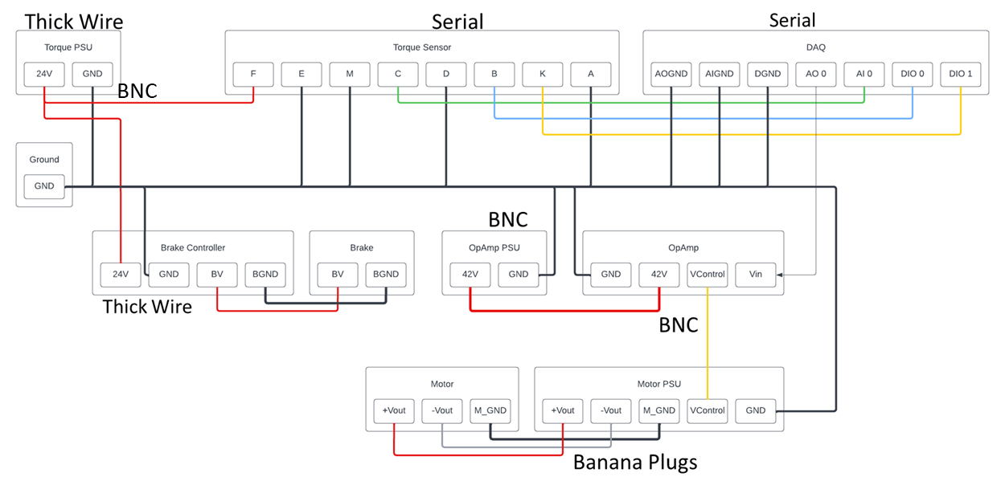
Plug Layout
2x Serial
2x Cable to Female
2x Male to Breakout
3x BNC
3x Female BNC to Wire
3x Male BNC to Wire
1x Banana
Already have them

Slide 36
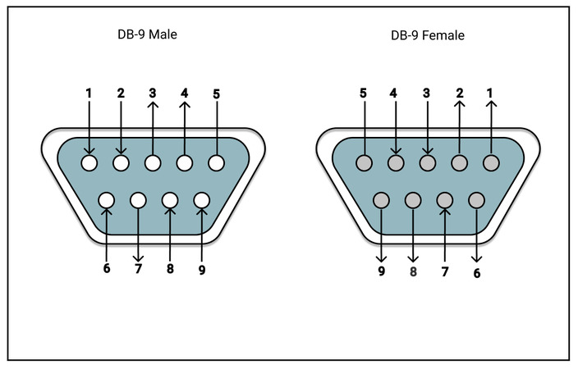
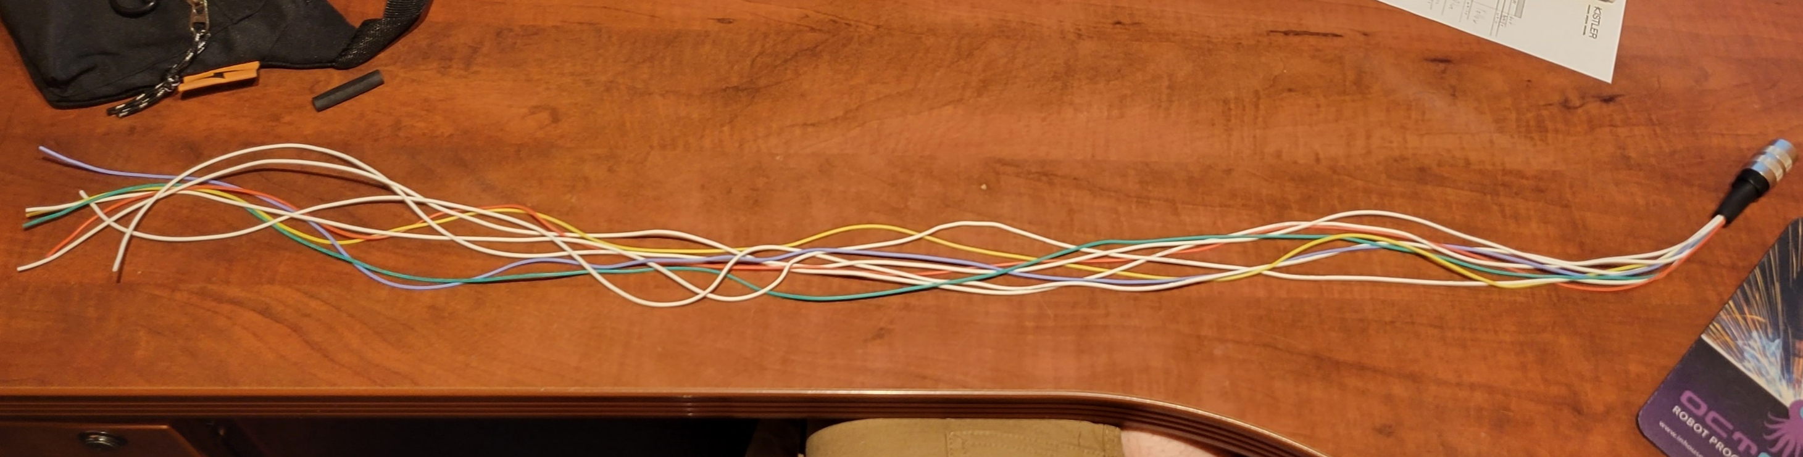
Resoldering Cable To Be Longer And Serial

Slide 37
DAQ Is Also Going To Be Serial

Slide 38
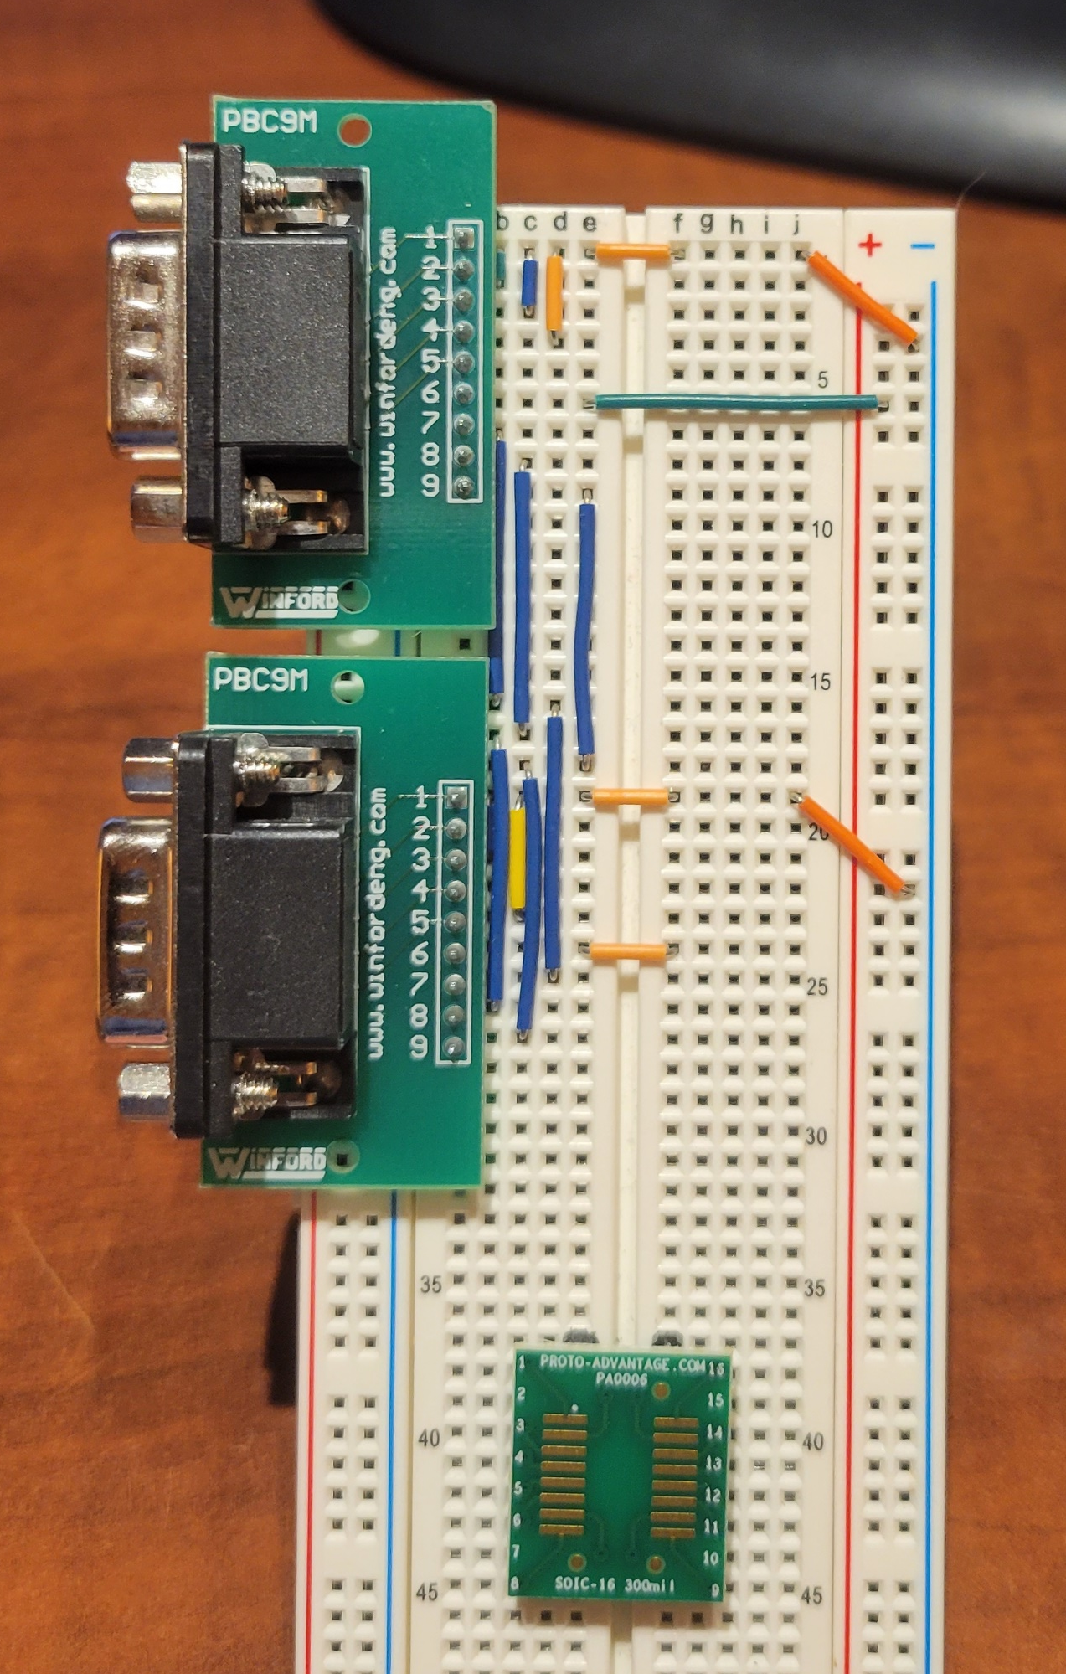
Breadboarding the Protoboard Plan
Not going to make the final circuit board on a breadboard
Just using it to figure out protoboard layout
Will plug in breadboard to ensure everything works
Hoping to transfer onto protoboard next week

